Slide 1
E-Commerce Analysis
Submitted by Nalina Lingasamy DTM10

Slide 2
Problem statement
This analysis aims to provide insights into various aspects of product data collected from a major Indian e-commerce platform.

Slide 3
Data cleaning and Pre-processing
Dataset was loaded in Jupyter notebook.
Null values and datatypes were checked for all columns in the dataset.
The data types were checked and data type conversion were made to make the data suitable for further analysis.
The product column in data set was exploded and the categories were separated into columns.
Outliers were identified using Box plot.
Various descriptive statistics were analyzed.

Slide 4
Data cleaning and Pre-processing
The final treated data set was then exported as an excel file.
The exported excel file was then loaded in PowerBI for analysis.
Various parameters were analysed and graphs were plotted.
From the plotted graphs, various insights were found for recommendations.

Slide 5
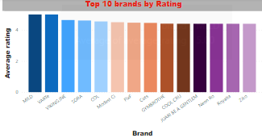
Data Analysis
﻿﻿﻿MILD and VARTe tied for highest Average of average_rating at 5, followed by VIKING.INE.﻿﻿ ﻿﻿ ﻿﻿
Across all 14 brand, Average of average_rating ranged from 4.40 to 5.﻿﻿ ﻿﻿ ﻿

Slide 6
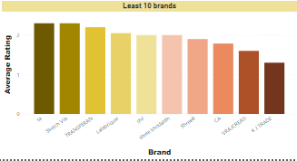
Data Analysis
﻿At 2.30, ta had the highest Average of average_rating and was 76.92% higher than K J TRADE, which had the lowest Average of average_rating at 1.30.﻿﻿
﻿ta had the highest Average of average_rating at 2.30, followed by Sketch Vib and TRANSPERAN. K J TRADE had the lowest Average of average_rating at 1.30.﻿﻿ ﻿﻿
﻿﻿Across all 10 brand, Average of average_rating ranged from 1.30 to 2.30.﻿﻿ ﻿﻿ ﻿

Slide 7
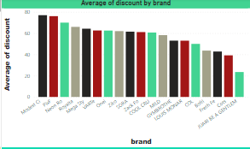
Data Analysis
At 77.00, Modest Ci had the highest Average of discount and was 227.66% higher than JUARI BE A GENTLEM, which had the lowest Average of discount at 23.50.﻿﻿ ﻿﻿ ﻿﻿
Across all 19 brand, Average of discount ranged from 23.50 to 77.00.﻿﻿ ﻿﻿ ﻿

Slide 8
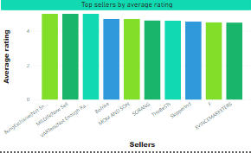
Data Analysis
﻿﻿ ﻿The top 3 seller all had Average of average_rating of 5.﻿﻿ ﻿﻿
﻿﻿Across all 10 seller, Average of average_rating ranged from 4.49 to 5.﻿﻿ ﻿﻿ ﻿

Slide 9
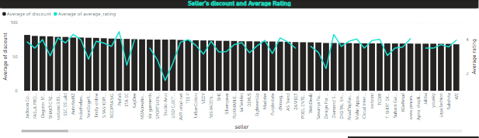
Data Analysis
Average of discount and total Average of average_rating are negatively correlated with each other.﻿﻿ ﻿﻿ ﻿﻿
Average of discount and Average of average_rating diverged the most when the seller was Jackson Consolidate, when Average of discount were 77.94 higher than Average of average_rating.﻿﻿
﻿﻿﻿﻿Across all 527 seller, Average of discount ranged from 1.00 to 81.80 and Average of average_rating ranged from 1.60 to 5.﻿﻿ ﻿﻿ ﻿

Slide 10
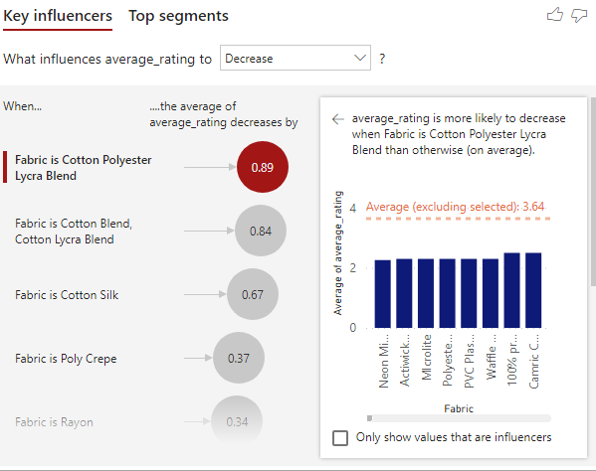
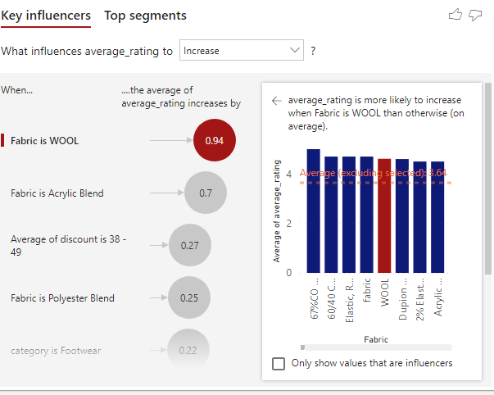
Data Analysis

Slide 11
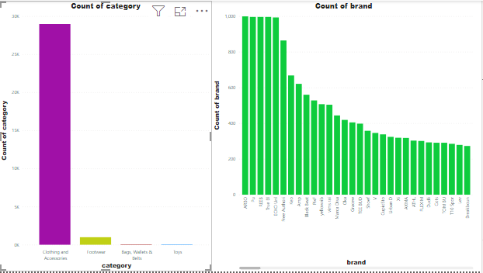
Data Analysis

Slide 12
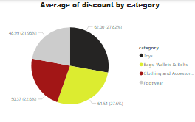
Data Analysis
Toys had the highest Average of discount at 62.00, followed by Bags, Wallets & Belts, Clothing and Accessories, and Footwear.﻿﻿ ﻿﻿ ﻿

Slide 13
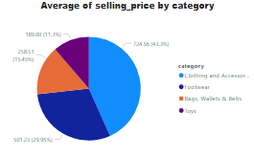
Data Analysis
﻿Clothing and Accessories had the highest Average of selling_price at 724.56, followed by Footwear, Bags, Wallets & Belts, and Toys.﻿﻿ ﻿﻿ ﻿

Slide 14
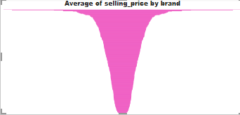
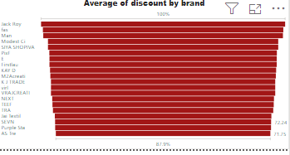
Data Analysis

Slide 15
Brand Performance Analysis
Brands like MILD, VARTe, and VIKING.INE have consistently high average ratings, indicating strong customer satisfaction.
It would be beneficial to study their marketing strategies, product quality, and customer service practices to identify factors contributing to their success.

Slide 16
Brand Improvement Opportunities
Brands with lower average ratings, such as K J TRADE, might benefit from analyzing customer feedback to pinpoint areas for improvement.
Implementing strategies to enhance product quality, customer service, and overall brand experience could lead to improved ratings and customer retention.

Slide 17
Discount Strategy Optimization
There appears to be a negative correlation between average discount and average rating.
While offering discounts can attract customers, excessively high discounts may raise questions about product quality or brand value.
Brands should carefully evaluate their discounting strategies to ensure they align with customer perceptions and brand positioning.

Slide 18
Seller Performance Evaluation
Jackson Consolidate stands out as a seller with a significant disparity between average discount and average rating.
This suggests a potential inconsistency between pricing and customer satisfaction.
Sellers should aim for more balanced pricing strategies that maintain profitability while satisfying customer expectations.

Slide 19
Product Category Insights
Toys have the highest average discount, indicating potential pricing flexibility in this category.
Brands could leverage this insight to run targeted promotions and attract price-sensitive customers.
Conversely, Clothing and Accessories command higher selling prices, suggesting a perceived value or premium positioning within this category.

Slide 20
Customer Feedback Analysis
Conducting in-depth analysis of customer feedback across brands and product categories can provide valuable insights into customer preferences, pain points, and areas for improvement.
Brands can use this information to tailor their offerings and enhance customer satisfaction.

Slide 21
Competitive Benchmarking
Benchmarking against competitors can provide valuable insights into market trends, pricing strategies, and customer preferences.
Brands should continuously monitor competitor performance and adapt their strategies accordingly to maintain a competitive edge.

Slide 22
Customer Engagement Initiatives
Implementing customer engagement initiatives such as loyalty programs, personalized recommendations, and interactive content can foster stronger relationships with customers and encourage repeat purchases.
Brands should prioritize building long-term customer loyalty to drive sustainable growth.

Slide 23
THANK YOU

